Slide 1

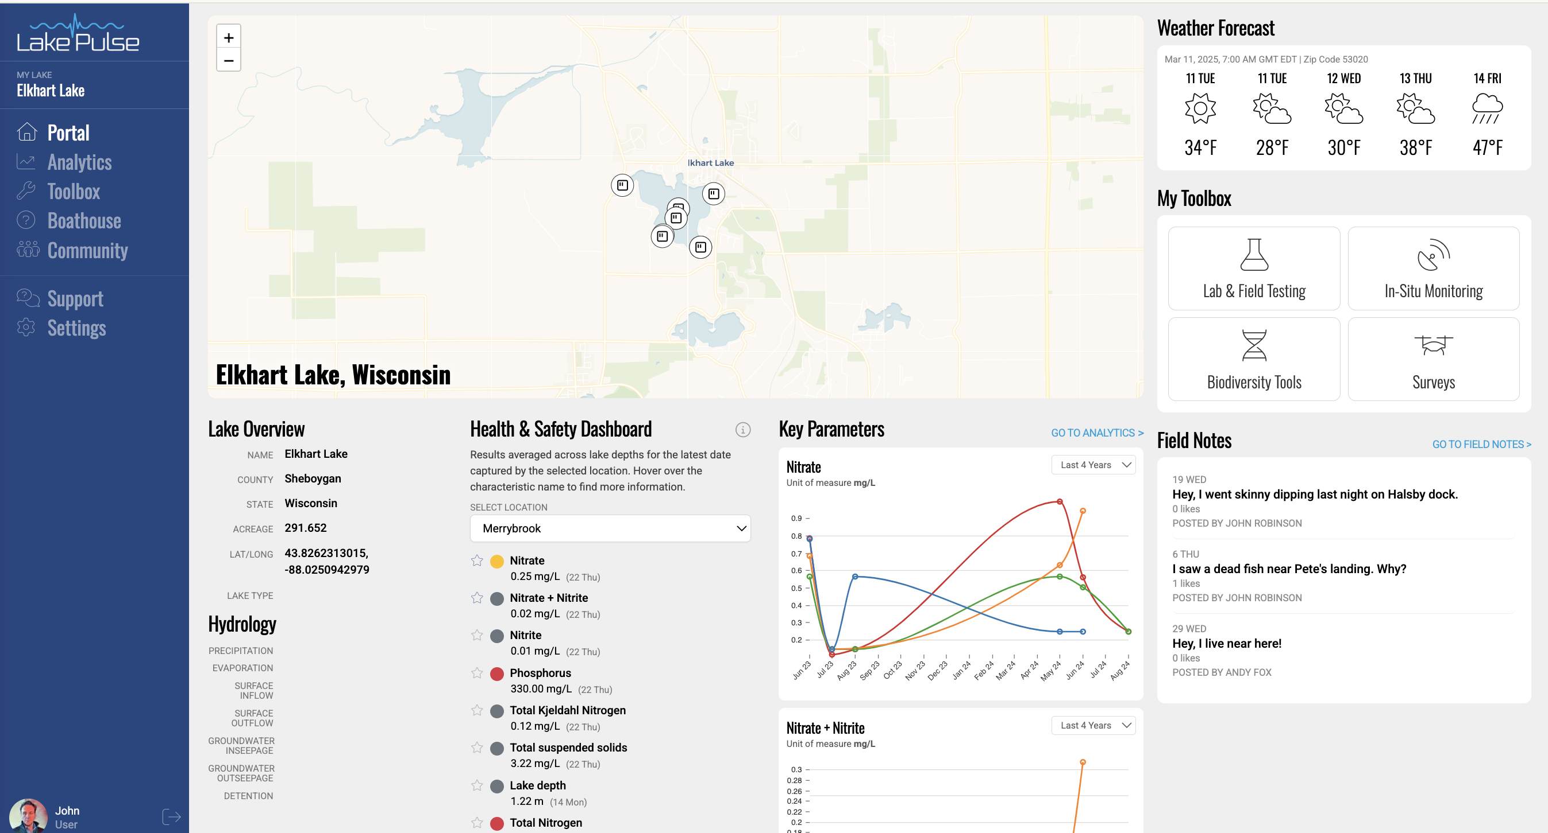
Buy testing & monitoring tools
ecommerce
Manage lake health & safety data
Subscription
Portal | Data | Analytics | Boathouse | Community
An overview of lake vitals, overall health, recent activity, etc Tools like Field Notes enhance collaboration See what testing & monitoring solutions have been bought, and by who in Toolbox Admin | All your lake health & safety data in one place | Slice and dice your lake’s data to compare your lake with others of similar size and geography | Discuss your lake’s issues with lake health expert via email, phone, or cat Help you figure out what testing & monitoring tools you need? Support your efforts to apply for state grants | Sharing lake health & safety data with the broader community Survey the community, enlist support, highlight up coming lake health & safety events
Buy the solutions you need in LP Shopify store
Complete the action (install, sample, etc)
Data (results) auto move from vendor API over to LPFD
Chat with the Boathouse from within Toolbox
Instead of building out LP on Squarespace, maybe Graham just builds the ‘brochure’ site here???
Other?
Fresh thinking: There very well may be advantages to configuring the business like this (two verticals). Think about why this might actually be ‘better’, and why it might be worse.

Slide 2
Menu
Portal
Toolbox Data Analytics
Boathouse
Community
Menu
Portal - Done
Toolbox - Shopify Data - See next page Analytics _ coming soon
Boathouse – Form
Community – Coming soon

Slide 3






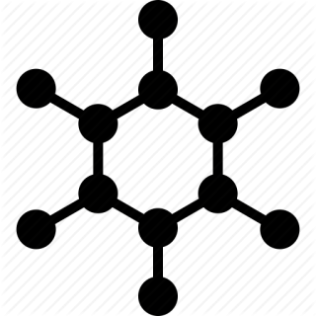








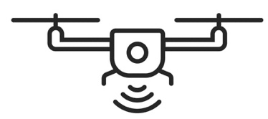




Data Library
The definitive source for your lake’s health & safety data
ACCOUNT
PORTAL
TOOLBOX
DATA
ANALYTICS
COMMUNITY
Physical | Chemical | Biological | Hydrological | Watershed | Weather | Access
Includes size, depth, volume, shoreline complexity, elevation, water level fluctuations, ice cover, evaporation, and sediment composition, all essential for understanding lake hydrology and structure DATA | Involves pH, dissolved oxygen, nutrient levels (nitrates, phosphates), turbidity, salinity, heavy metals, and organic pollutants, crucial for water quality, pollution detection, and aquatic life sustainability. DATA | Covers fish populations, aquatic vegetation, plankton communities, invasive species, biodiversity, and habitat conditions, helping assess ecosystem health and species dynamics. DATA | Tracks inflow/outflow rates, groundwater connections, precipitation, evaporation, and water retention time, providing insights into a lake’s water balance and movement. DATA | Includes land use, soil type, vegetation cover, runoff patterns, and pollution sources, helping understand how surrounding landscapes impact lake health and water quality. DATA | Tracks inflow/outflow rates, groundwater connections, precipitation, evaporation, and water retention time, providing insights into a lake’s water balance and movement. DATA | Includes boat landings, marinas, beaches, swimming areas, fishing piers, and public entry points, helping assess recreational use, infrastructure, and human impact on the lake. DATA
* Please contact the Boathouse if you have questions on any data.
Data Sources
The Lake Pulse Toolbox has been leveraged to produce more health & safety data on your lake
SUPPORT
SETTINGS
Lab Results | Satellite | Drone | Field Testing | In-situ Monitoring | Fish & Mollusk Surveys | Historic Reports Uploaded
Raw data from the lab sampling that has been produced on your lake | Images from the satellite monitoring that has been produced on your lake | Images from the drone monitoring that has been produced on your lake | Raw data from the field testing that has been produced on your lake | Raw data from the buoys and dock monitoring that has been produced on your lake | Results from from the eDNA and eRNA sampling that has been produced on your lake | Historic reports on your lake that have been uploaded, with key data already extracted
J Robinson
jwr899@gmaillcom

Slide 4
Data Library
ACCOUNT
PORTAL
TOOLBOX
DATA Physical Chemical Biological Hydrologic Watershed Weather Access Lab Results Satellite Drone Field In-situ Survey
ANALYTICS
COMMUNITY
Physical: Includes size, depth, volume, shoreline complexity, elevation, water level fluctuations, ice cover, evaporation, and sediment composition, all essential for understanding lake hydrology and structure
Item | Measurement | Average (or most recent) result. | Description
Land Use - Urban/ Agriculture | % of watershed | 45% / 55% | Influences nutrient runoff, sedimentation, and pollution levels, making it essential to consider for effective water quality management and ecosystem protection.
Ice Thaw Date | Average date | 03 April | Reflects climate patterns, affects ice-related activities, and influences biological processes, such as fish spawning and oxygen dynamics.
Ice Cover | Y / N | Y | Influences oxygen levels, nutrient cycling, and the survival of aquatic organisms during colder months.
Lake Size | Acres | 430.03 | Influences water volume, habitat diversity, nutrient dynamics, and the lake’s susceptibility to external impacts like pollution or climate change.
Latitude | Degrees | 45.2325° N, 88.0076° W | Determins climate conditions, such as temperature, precipitation, and seasonal cycles, which influence water temperature, ice cover, and the biological and chemical processes within the lake.
Elevation | Feet above sea level | 665 | Important for understanding lake health and safety because it affects atmospheric pressure, temperature, and dissolved oxygen levels, influencing aquatic ecosystems and water quality.
Ice Freeze Date | Average date | 14 November | Reflects climate patterns, affects ice-related activities, and influences biological processes, such as fish spawning and oxygen dynamics.
Max Surface Temp | F | 81.4 | Reveals the effects of climate change, influences stratification, impacts dissolved oxygen levels, and affects the habitat suitability for aquatic life.
Average Depth | Feet | 25 | Influences temperature stratification, oxygen distribution, habitat zones, and the lake’s resilience to pollution and environmental changes.
Maximum Depth | Feet | 39 | Influences temperature stratification, oxygen distribution, habitat zones, and the lake’s resilience to pollution and environmental changes.
Water Level | Feet | 665 | Affects habitat availability, shoreline erosion, nutrient cycling, and the overall balance of the aquatic ecosystem.
Transparency | Feet | 11 | Reflects water clarity, which impacts aquatic life, photosynthesis, and indicates potential issues like algal blooms or sediment pollution.
Light Penetration | Feet | 11 | Affects photosynthesis, aquatic plant growth, and the overall productivity and balance of the lake’s ecosystem.
Sediment Composition | % of bottom covered by organic sediment | 22 | Reveals the sources of pollution, nutrient levels, and potential contaminants, influencing water quality, ecosystem dynamics, and habitat conditions.
Turbidity | NTU | 4 | Indicates the concentration of suspended particles, affecting water clarity, light penetration, photosynthesis, and the overall health of aquatic ecosystems.
SUPPORT
SETTINGS
J Robinson
jwr899@gmaillcom

Slide 5
Data Library
ACCOUNT
PORTAL
TOOLBOX
DATA Physical Chemical Biological Hydrologic Watershed Weather Access Lab Results Satellite Drone Field In-situ Survey
ANALYTICS
COMMUNITY
Chemical: Involves pH, dissolved oxygen, nutrient levels (nitrates, phosphates), turbidity, salinity, heavy metals, and organic pollutants, crucial for water quality, pollution detection, and aquatic life sustainability.
Item | Measurement | Average (or most recent) result. | Description
Dissolved Oxygen (DO) | mg/L | 3 | Determines the water’s ability to support aquatic life, indicating ecosystem health and identifying risks like hypoxia or fish kills.
pH | Standard Unit | 6 | Determines the water’s acidity or alkalinity, affecting aquatic life, nutrient availability, and the toxicity of pollutants.
Chlorides | mg/L | 55 | Elevated levels can indicate pollution from road salt, agricultural runoff, or industrial discharges, impacting aquatic ecosystems and water quality.
Hardness | mg/L | 30 | Reflects the concentration of calcium and magnesium ions, influencing aquatic organisms’ health, water chemistry, and the potential for scale formation.
Metals |  |  | Metals like mercury, lead, and arsenic can be toxic to aquatic life and humans, accumulate in the food chain, and indicate pollution sources or industrial contamination.
Sulfates | mg/L | 310 | High levels can indicate pollution from industrial or agricultural sources, affect water chemistry, and harm aquatic life and drinking water quality.
Un-ionized Ammonia | mg/L | 0.02 | Toxic to aquatic life at high concentrations, especially at elevated pH levels, and serves as an indicator of organic pollution and nutrient loading.
Total Nitrogen | mg/L | 1.25 | Influences algal blooms, water quality, and overall ecosystem balance, helping to identify and mitigate nutrient pollution.
Total Phosphorus | ug/L | 46 | A key nutrient driving algal growth and eutrophication, helping to assess and prevent water quality degradation.
Alkalinity | mg/L as CaCO3 | 12 | Reflects the water’s ability to neutralize acids, maintaining pH stability and buffering against environmental changes that can harm aquatic ecosystems.
Ammonium Nitrogen | mg/L | 0.6 | A readily available form of nitrogen for algae, can indicate organic pollution, and at high levels, is toxic to aquatic life.
Conductivity | Umhos/cm | 771 | Indicates the water’s ionic content, reflecting pollution levels, salinity, and overall water quality.
Nitrate Nitrogen | mg/L | 0.5 | Indicates nutrient loading, contributes to eutrophication, and can harm aquatic life and human health at high concentrations.
SUPPORT
SETTINGS
J Robinson
jwr899@gmaillcom

Slide 6
Data Library
ACCOUNT
PORTAL
TOOLBOX
DATA Physical Chemical Biological Hydrologic Watershed Weather Access Lab Results Satellite Drone Field In-situ Survey
ANALYTICS
COMMUNITY
Biological: Covers fish populations, aquatic vegetation, plankton communities, invasive species, biodiversity, and habitat conditions, helping assess ecosystem health and species dynamics.
Item | Measurement | Average (or most recent) result. | Description
Aquatic Vegetation | % cover | 65% | Provides habitat for aquatic life, influences oxygen levels, and reflects nutrient availability, while excessive growth can indicate eutrophication or potential ecological imbalances.
Fish Population |  |  | Reflects the overall ecological balance, water quality, and habitat conditions, serving as a key indicator of the lake’s ability to support a healthy aquatic ecosystem.
Macroinvertebrates |  | - | They serve as bioindicators, reflecting long-term water quality and ecosystem health due to their sensitivity to pollution, habitat changes, and environmental stressors.
Pathogens |  | - | Detects harmful microorganisms (e.g., E. coli, Cryptosporidium, or Giardia) that can cause waterborne diseases, ensuring the safety of recreational activities, drinking water, and aquatic ecosystems.
Parasites |  |  | Can affect the health of fish, wildlife, and humans, serving as indicators of ecosystem stress or contamination, and potentially causing diseases that impact biodiversity and public health. (eg: Giardia, Cryptosporidium, Schistosoma, etc affecting humans, and "Ich", Diplostomum spp,Lernaea, etc affecting fish.)
Phytoplankton | ug/L | 5,400 | They form the base of the aquatic food web, provide insights into nutrient levels, and help identify imbalances that can lead to issues like algal blooms or ecosystem disruptions.
Zooplankton | ug/L | 45 | They form the base of the aquatic food web, provide insights into nutrient levels, and help identify imbalances that can lead to issues like algal blooms or ecosystem disruptions.
Chlorophyll-a | ug/L | 18 | Serves as a key indicator of algal biomass, helping to assess eutrophication levels and potential risks from harmful algal blooms.
Cyanobacteria | cells/mL | 72,000 | Directly assesses the presence and abundance of harmful algae that can produce toxins, posing risks to aquatic ecosystems, drinking water, and recreational use.
Invasive Species | % of community as cover or biomass | - | They disrupt ecosystems, outcompete native species, and can cause economic and ecological damage.
Phycocyanin | ug/L | 14 | A specific indicator of cyanobacteria (blue-green algae), helping to identify the presence and severity of harmful algal blooms that can threaten water quality and safety.
SUPPORT
SETTINGS
J Robinson
jwr899@gmaillcom

Slide 7
Data Library
ACCOUNT
PORTAL
TOOLBOX
DATA Physical Chemical Biological Hydrologic Watershed Weather Access Lab Results Satellite Drone Field In-situ Survey
ANALYTICS
COMMUNITY
Hydrological: Tracks inflow/outflow rates, groundwater connections, precipitation, evaporation, and water retention time, providing insights into a lake’s water balance and movement.
Item | Measurement | Average (or most recent) result. | Description
Inflow | Cubic feet per second | 9 | Determines the supply of water, nutrients, and sediments entering the lake, influencing water quality, ecosystem dynamics, and the balance between water inputs and losses.
Outflow | Cubic feet per second | 12 | Regulates water levels, removes excess nutrients and sediments, and impacts downstream ecosystems, ensuring the balance and sustainability of the lake system.
Runoff Volume & Rate | % of inflow | 35 | Determine the amount of water, nutrients, and pollutants entering the lake, directly impacting water quality, erosion, and the risk of flooding.
Detention Time | Days | 40 | Determines how long water and its associated nutrients, pollutants, or sediments remain in the lake, affecting water quality, ecological processes, and the lake’s response to environmental changes.
Precipitation | Inches / year | 24.7 | Influences water levels, runoff, and the transport of nutrients and pollutants into the lake, directly impacting water quality, ecosystem balance, and flood risk.
Evaporation | Inches / year | 32 | Affects water levels, salinity, and temperature, influencing aquatic habitats, water availability, and the overall balance of the lake’s ecosystem.
Groundwater Interaction | Low, medium, high | high | Influences water levels, temperature, and nutrient exchange, impacting water quality, ecosystem balance, and the lake’s resilience to external stressors like droughts or pollution, including from septic tanks.
Water Level Fluctuations | Max Ft variation / year | 2.3 | Affect shoreline erosion, habitat availability, nutrient cycling, and the balance of aquatic ecosystems, while also influencing human activities like water supply and recreation.
SUPPORT
SETTINGS
J Robinson
jwr899@gmaillcom

Slide 8
Data Library
ACCOUNT
PORTAL
TOOLBOX
DATA Physical Chemical Biological Hydrologic Watershed Weather Access Lab Results Satellite Drone Field In-situ Survey
ANALYTICS
COMMUNITY
Watershed: Includes land use, soil type, vegetation cover, runoff patterns, and pollution sources, helping understand how surrounding landscapes impact lake health and water quality.
Item | Measurement | Average (or most recent) result. | Description
Watershed to Lake Area Ratio | Ratio | 12:1 | Determines level of influence of watershed in any given season or year, likely detention time, flushing rate, and other hydrologic features
Watershed Area | Sq. mi | 59 | Determines the volume of water, sediment, and nutrients flowing into the lake, influencing its water quality, ecological dynamics, and susceptibility to pollution.
Impervious Surface Coverage | % | 0.1% | Increases runoff, reduces groundwater recharge, and transports pollutants like nutrients, sediments, and chemicals into the lake, negatively affecting water quality and ecosystem health.
Nutrient Loading | g P/m2 of lake per year | 0.25 | Excessive nutrients, such as nitrogen and phosphorus, can drive algal blooms, deplete oxygen levels, and disrupt aquatic ecosystems, leading to poor water quality and potential health risks.
Sediment Load | kg /acre of watershed/yr | 31 | Excessive sediment can reduce water clarity, smother aquatic habitats, transport pollutants, and alter nutrient dynamics, negatively affecting the lake ecosystem.
Soil Type & Erodibillity | Low, Medium, High | Low | Influence the amount of sediment, nutrients, and pollutants entering the lake through runoff, affecting water quality and ecosystem stability.
Land Vegetative Cover | Low, Medium, High | High | Reduces erosion, filters pollutants, regulates runoff, and provides habitat for wildlife, contributing to the overall stability and quality of the lake ecosystem.
Point Source Pollution | # discharges or total cfs of discharge | 0 | Direct discharges of pollutants from identifiable sources, such as industrial outfalls or wastewater treatment plants, which can degrade water quality and harm aquatic life.
Shoreline Erosion | % of shoreline with erosion evidence | 0% | Contributes to sedimentation, habitat loss, and nutrient loading, impacting water quality, aquatic ecosystems, and the stability of surrounding land.
NonPoint Source Pollution |  |  | Involves diffuse runoff from sources like agriculture, urban areas, and roads, which can carry nutrients, sediments, and toxins into the lake, degrading water quality and ecosystems.
SUPPORT
SETTINGS
J Robinson
jwr899@gmaillcom

Slide 9
Data Library
ACCOUNT
PORTAL
TOOLBOX
DATA Physical Chemical Biological Hydrologic Watershed Weather Access Lab Results Satellite Drone Field In-situ Survey
ANALYTICS
COMMUNITY
Weather: Covers fish populations, aquatic vegetation, plankton communities, invasive species, biodiversity, and habitat conditions, helping assess ecosystem health and species dynamics.
Item | Measurement | Average (or most recent) result. | Description
Rainy Days / year | Days | 106
Total Rainfall /year | Inches | 30
Sunny days | Days | 188
Avg High Temp | F | 81
Avg Low Temp | F | 3
SUPPORT
SETTINGS
J Robinson
jwr899@gmaillcom

Slide 10
Data Library
ACCOUNT
PORTAL
TOOLBOX
DATA Physical Chemical Biological Hydrologic Watershed Weather Access Lab Results Satellite Drone Field In-situ Survey
ANALYTICS
COMMUNITY
Access: Includes boat landings, marinas, beaches, swimming areas, fishing piers, and public entry points, helping assess recreational use, infrastructure, and human impact on the lake.
Item | Measurement | Average (or most recent) result. | Description
Boat Landings | # | 1 | Boat landings are key access points for recreational boating but pose risks to lake health and safety. They are major entry points for invasive species, as boats and trailers can carry zebra mussels, Eurasian watermilfoil, and other aquatic hitchhikers. Frequent boat traffic can also lead to fuel spills, oil leaks, and sediment disruption, affecting water clarity and aquatic ecosystems. Additionally, improper use of ramps and nearby parking areas can contribute to runoff pollution and shoreline erosion.
Swimming Beaches | # | 2 | Swimming beaches are highly sensitive to bacterial contamination, including E. coli and harmful algal blooms (HABs), which pose risks to public health. Stormwater runoff, wastewater leakage, and wildlife waste can introduce pathogens, leading to swimming advisories or closures. Additionally, sudden drop-offs, strong currents, and unpredictable weather can create drowning hazards, making real-time monitoring of water quality and safety conditions essential.
Harbors / Marinas | # | 0 | Harbors and marinas are high-traffic boating areas that introduce chemical pollution from fuel spills, antifouling paints, and wastewater discharge. The concentration of boats can increase wave action and sediment resuspension, leading to shoreline erosion and habitat disturbance. Dredging and construction activities can further disrupt fish spawning areas and aquatic vegetation, impacting biodiversity. Proper management, such as waste disposal stations, no-wake zones, and stormwater filtration, is crucial to balancing recreation with environmental protection.
SUPPORT
SETTINGS
J Robinson
jwr899@gmaillcom

Slide 11
Data Sources
ACCOUNT
PORTAL
TOOLBOX
DATA Physical Chemical Biological Hydrologic Watershed Weather Access Lab Results Satellite Drone Field In-situ Survey
ANALYTICS
COMMUNITY
Lab Results: A central repository of lab tests conduced on your lake.
SUPPORT
SETTINGS
J Robinson
jwr899@gmaillcom

Slide 12
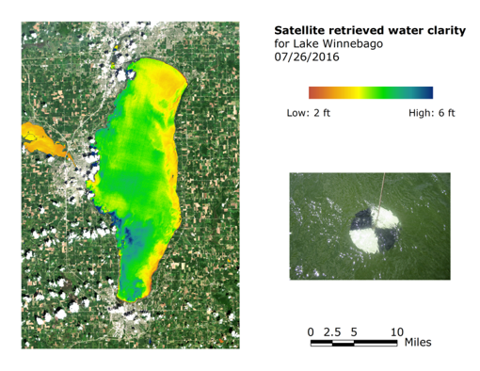
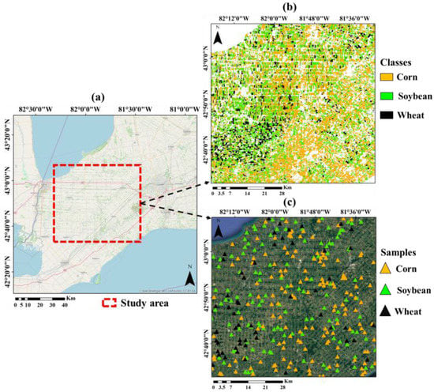

Data Sources
ACCOUNT
PORTAL
TOOLBOX
DATA Physical Chemical Biological Hydrologic Watershed Weather Access Lab Results Satellite Drone Field In-situ Survey
ANALYTICS
COMMUNITY
Satellite Insights: A central repository of satellite imagry conduced on your lake.
SUPPORT
SETTINGS
J Robinson
jwr899@gmaillcom

Slide 13
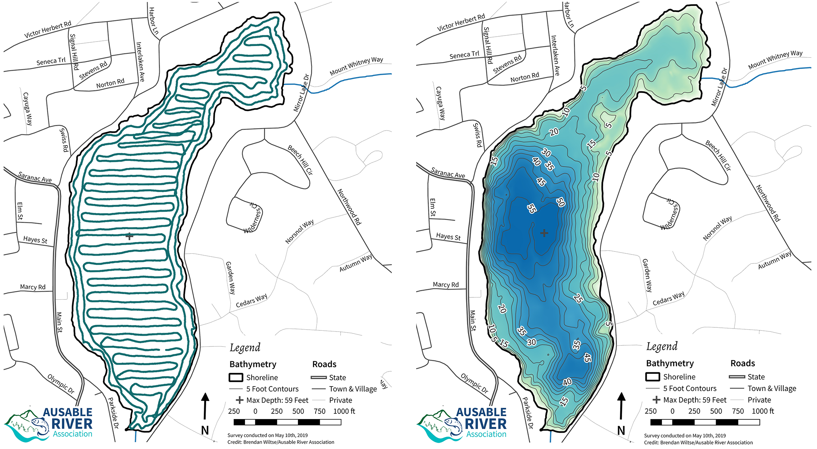
Data Sources
ACCOUNT
PORTAL
TOOLBOX
DATA Physical Chemical Biological Hydrologic Watershed Weather Access Lab Results Satellite Drone Field In-situ Survey
ANALYTICS
COMMUNITY
Drone Insights: A central repository of drone imagery conduced on your lake.
SUPPORT
SETTINGS
J Robinson
jwr899@gmaillcom

Slide 14
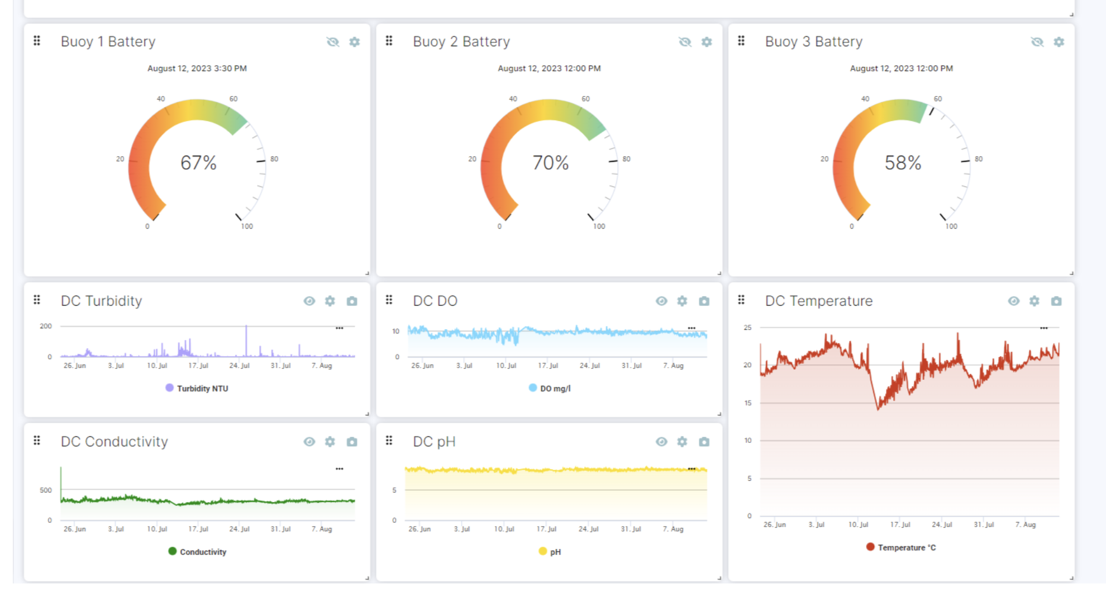
Data Sources
ACCOUNT
PORTAL
TOOLBOX
DATA Physical Chemical Biological Hydrologic Watershed Weather Access Lab Results Satellite Drone Field In-situ Survey
ANALYTICS
COMMUNITY
In-sity Insights: A central repository of in-situ monitoring conduced on your lake.
SUPPORT
SETTINGS
J Robinson
jwr899@gmaillcom

Slide 15
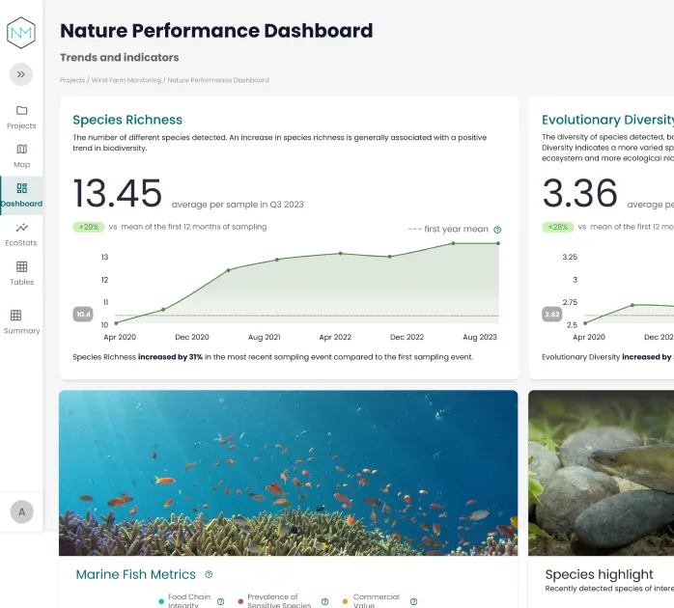
Data Sources
ACCOUNT
PORTAL
TOOLBOX
DATA Physical Chemical Biological Hydrologic Watershed Weather Access Lab Results Satellite Drone Field In-situ Survey
ANALYTICS
COMMUNITY
Genomics Surveys: A central repository of genomics data on your lake
SUPPORT
SETTINGS
J Robinson
jwr899@gmaillcom

Slide 16

Data Sources
ACCOUNT
PORTAL
TOOLBOX
DATA Physical Chemical Biological Hydrologic Watershed Weather Access Lab Results Satellite Drone Field In-situ Survey
ANALYTICS
COMMUNITY
Uploaded Data: A central repository everything that has been uploaded on your lake
SUPPORT
SETTINGS
J Robinson
jwr899@gmaillcom

Slide 17


Analytics
Get a deeper understanding of your lake’s health & safety
ACCOUNT
PORTAL
TOOLBOX
DATA
ANALYTICS
COMMUNITY
Run analytics on my lake
Let’s see what your risks you might face
Compare my lake with other similar lakes
Benchmarking
etc
SUPPORT
SETTINGS
J Robinson
jwr899@gmaillcom

